Slide 1
Math. for CS
Ch 2- The Well Ordering Principle
Prof. Shunxiang Zhang
Anhui University of Science & Technology
Computer Science and Engineering
Mobile Phone：189-6377-7827
Email：sxzh666@gmail.com;sxzhang@aust.edu.cn

Slide 2
Topics covered/Contents
2.1 Well Ordering Proofs
2.2 Template for Well Ordering Proofs
2.3 Factoring into Primes
2.4 Well Ordered Sets

Slide 3
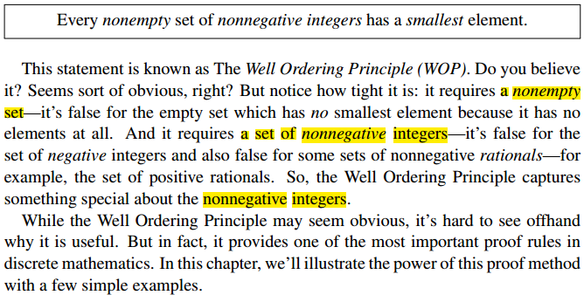
Ch 2- The Well Ordering Principle

Slide 4
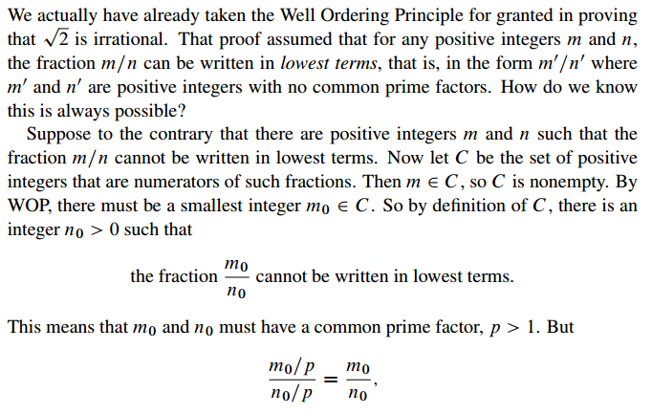
2.1 Well Ordering Proofs

Slide 5
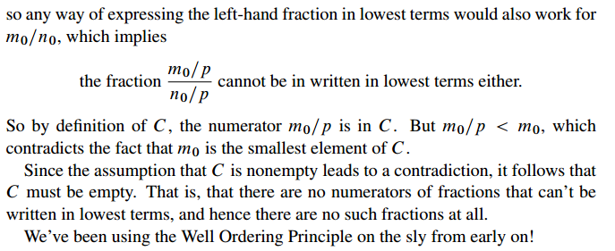
2.1 Well Ordering Proofs

Slide 6
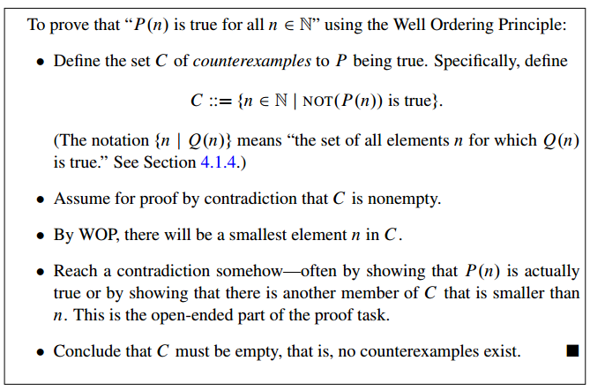
2.2 Template for Well Ordering Proofs
More generally, there is a standard way to use Well Ordering to prove that some
property, P(n) holds for every nonnegative integer n. Here is a standard way to
organize such a well ordering proof:

Slide 7
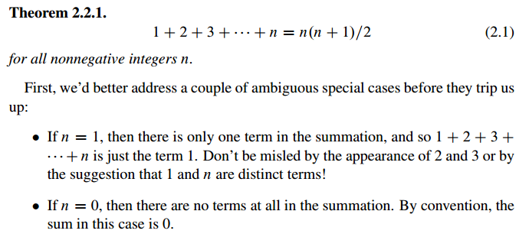
2.2 Template for Well Ordering Proofs
2.2.1 Summing the Integers Let’s use this template to prove

Slide 8
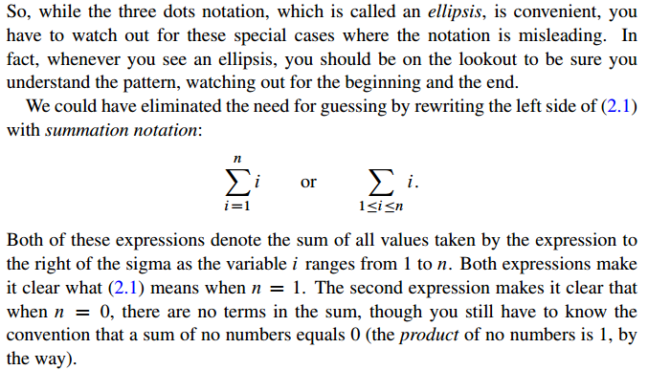
2.2 Template for Well Ordering Proofs

Slide 9
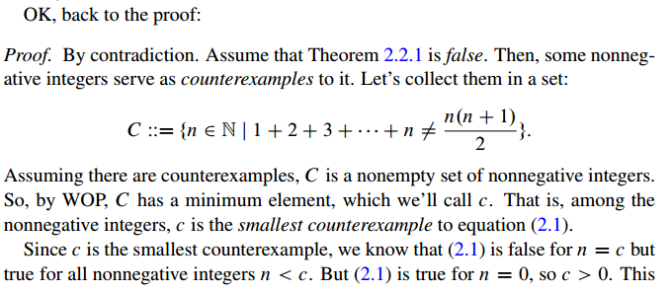
2.2 Template for Well Ordering Proofs

Slide 10
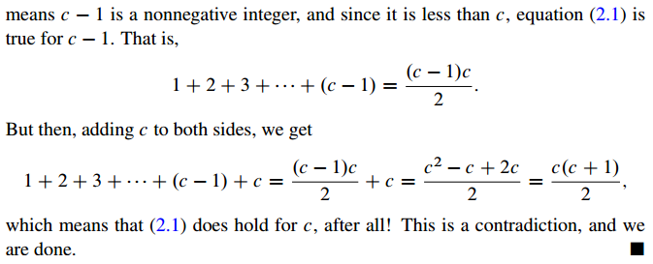
2.2 Template for Well Ordering Proofs

Slide 11
2.3 Factoring into Primes
We’ve previously taken for granted the Prime Factorization Theorem, also known as the Unique Factorization Theorem and the Fundamental Theorem of Arithmetic, which states that every integer greater than one has a unique expression as a product of prime numbers. This is another of those familiar mathematical facts which are taken for granted but are not really obvious on closer inspection. We’ll prove the uniqueness of prime factorization in a later chapter, but well ordering gives an easy proof that every integer greater than one can be expressed as some product of primes.

Slide 12
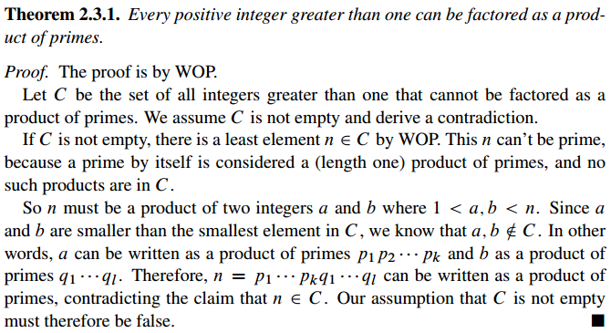
2.3 Factoring into Primes

Slide 13
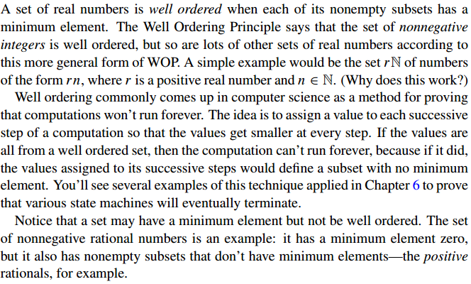
2.4 Well Ordered Sets

Slide 14
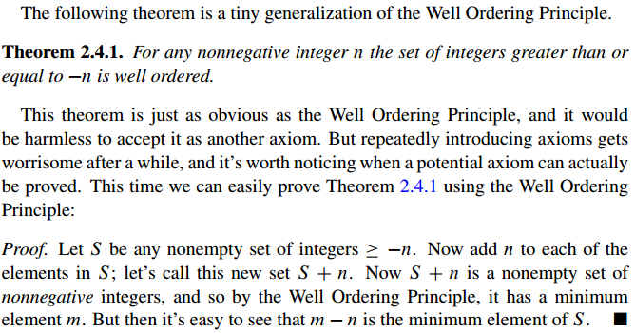
2.4 Well Ordered Sets

Slide 15
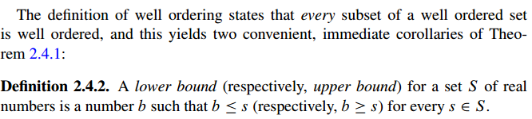
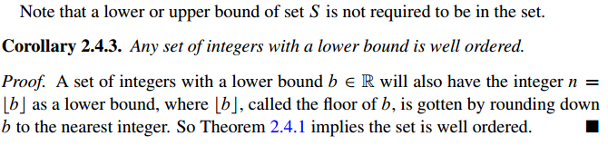
2.4 Well Ordered Sets

Slide 16
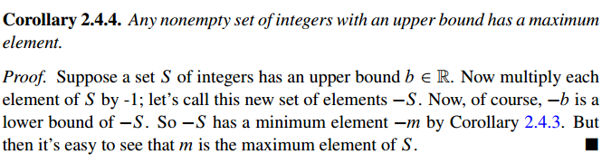
2.4 Well Ordered Sets

Slide 17


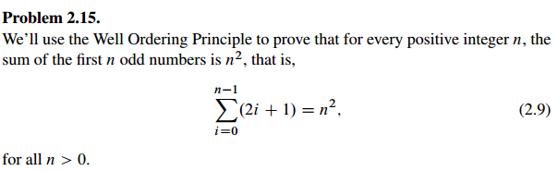
2.5 Group/Panel discussion
Group 1

Slide 18

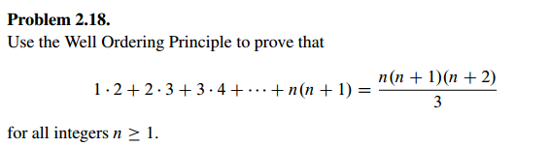
2.5 Group/Panel discussion
Group 2

